Slide 1
Reconfiguration and Extensibility For Low-Latency Key-Value Stores
Chinmay Kulkarni
University of Utah

Slide 2




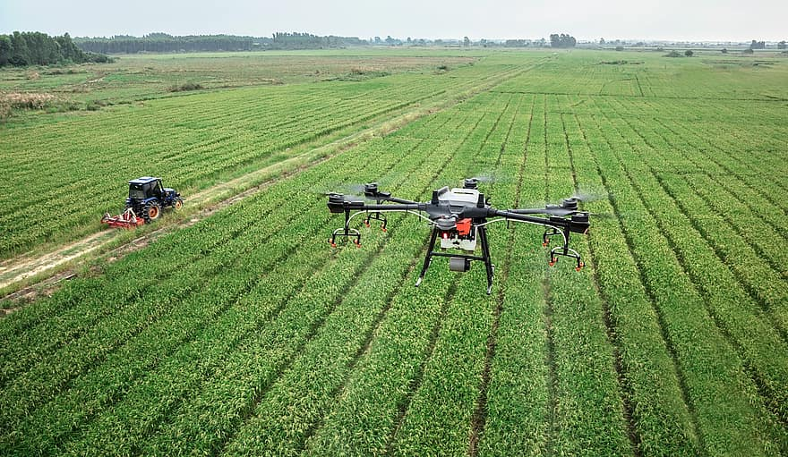
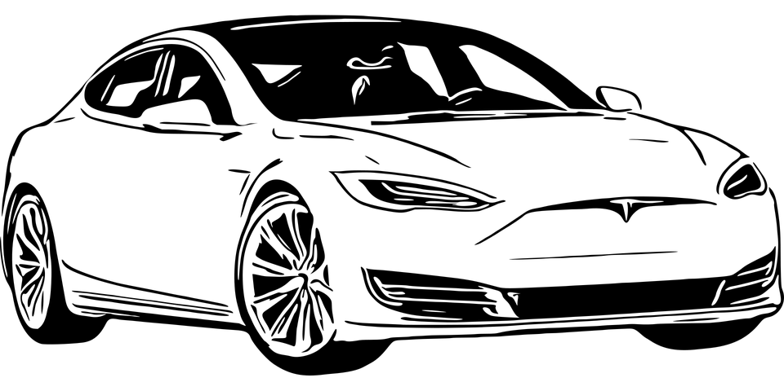
Millions of Devices are Generating Millions of Events Every Second
Notes:
Events per second?
(Say:) Donald Kaussman spoke of this during his talk last year!!

Slide 3

Events,
Data
Ad hoc
Batch Analysis
Cloud
Services
Sensors, Devices, IoT...
Aggregated in the Cloud to Gain Insights and Drive Application Logic

Slide 4
Events,
Data
Ad hoc
Batch Analysis
Ad hoc
Batch Analysis
Cloud
Services
Ad hoc
Analysis
Batch Analysis
Streaming
Ingest
Query
State Management
Sensors, Devices, IoT...

Slide 5
State Management
The crucial piece in the pipeline
Focal point for massive number of events and queries
Responsible for ingestion, indexing, availability, fault-tolerance etc.
Typically a Key-Value data model (Key-Value Store)
key(User-id): value{ Linkedin profile }
key(Pacemaker Device-id): value{ # of heartbeats in the last n minutes }

Slide 6
Key-Value Stores: Data Model
Application
Client
Records belong to a 64 bit hash space
[0, 2^{^63} - 1)
Put(key, value)
Get(key)
Server
Hash Table
Records

Slide 7
Key-Value Stores: Typical Deployment
Application
Client
Application
Client
Application
Client
Application
Client
Records are hash partitioned across servers
Network
Server
Server
Server
Server
Disaggregate Servers from Clients over Network, Scale-out each Independently

Slide 8
Key-Value Stores: Record Ownership
Application
Client
Application
Client
Application
Client
Application
Client
Ownership Mappings
Hash Range -> Server
Metadata Store
Network
Server
Server
Server
Server
Servers own partitions: order requests, provide durability and crash recovery

Slide 9
Key-Value Stores: Record Ownership
Application
Client
Application
Client
Application
Client
Application
Client
Ownership Mappings
Hash Range -> Server
Metadata Store
Network
Server
Server
Server
Server
Clients cache mappings, route requests to correct owner

Slide 10



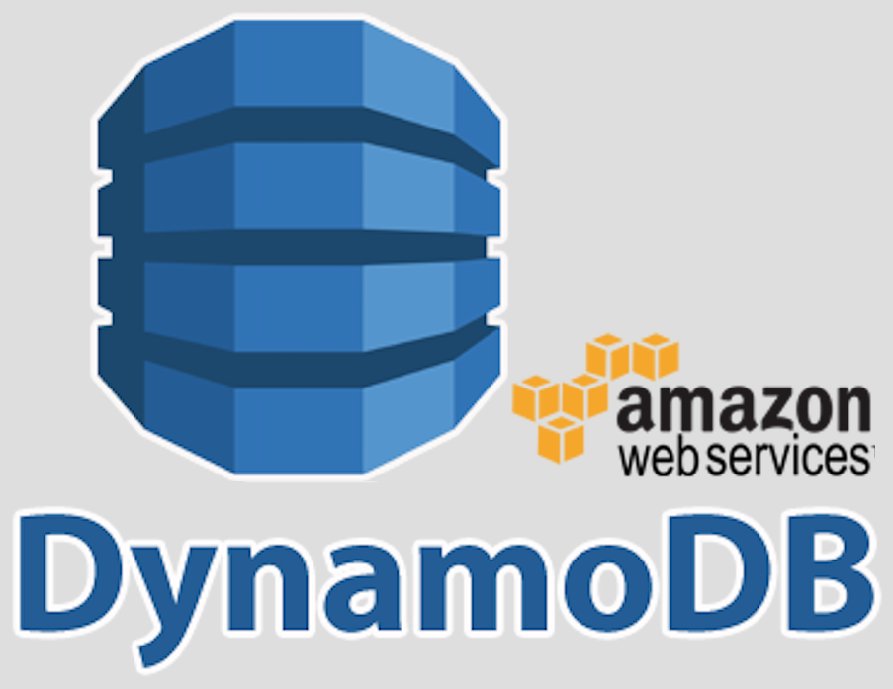
Key-Value Stores: Example Systems

Slide 11
Key-Value Stores: Data Migration
Server
Server
Server
Server
Servers often need to horizontally re-distribute load and data (Slicer, OSDI’16)
Clusters need to be scaled up and scaled down
Workloads change; access patterns, load imbalances etc
“Planned failures”; server maintenance, software updates etc

Slide 12
Key-Value Stores: Extensibility
Application
Client
Application
Client
Application
Client
Application
Client
Put(key, value) , Get(key), assoc_range(key), assoc_get(key)
Some applications need rich data model/vertical interface (Facebook Tao, ATC’13)
Get friend list (assoc_get())
Get friends of friends (assoc_range())

Slide 13
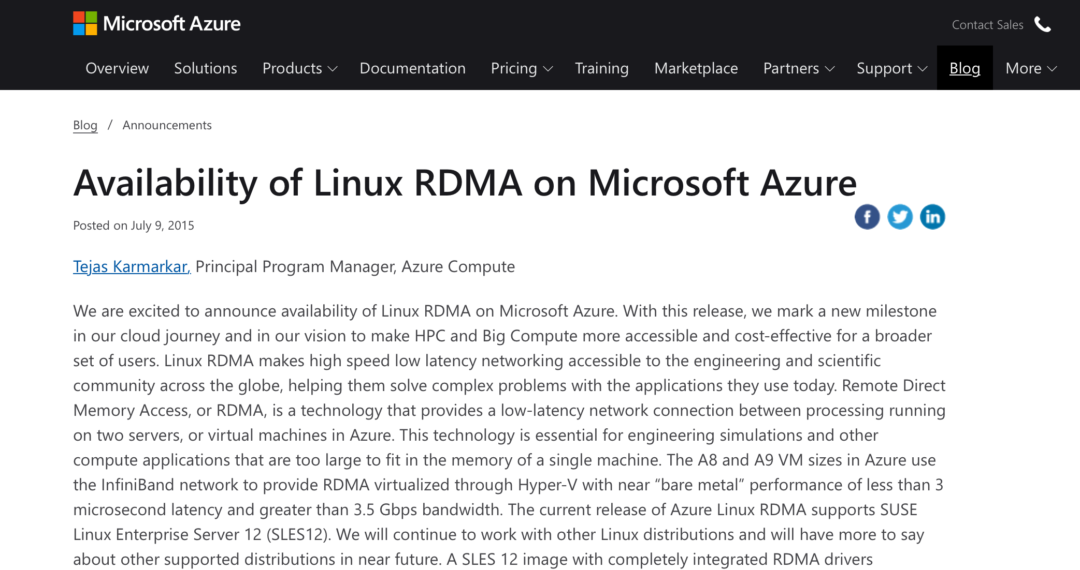
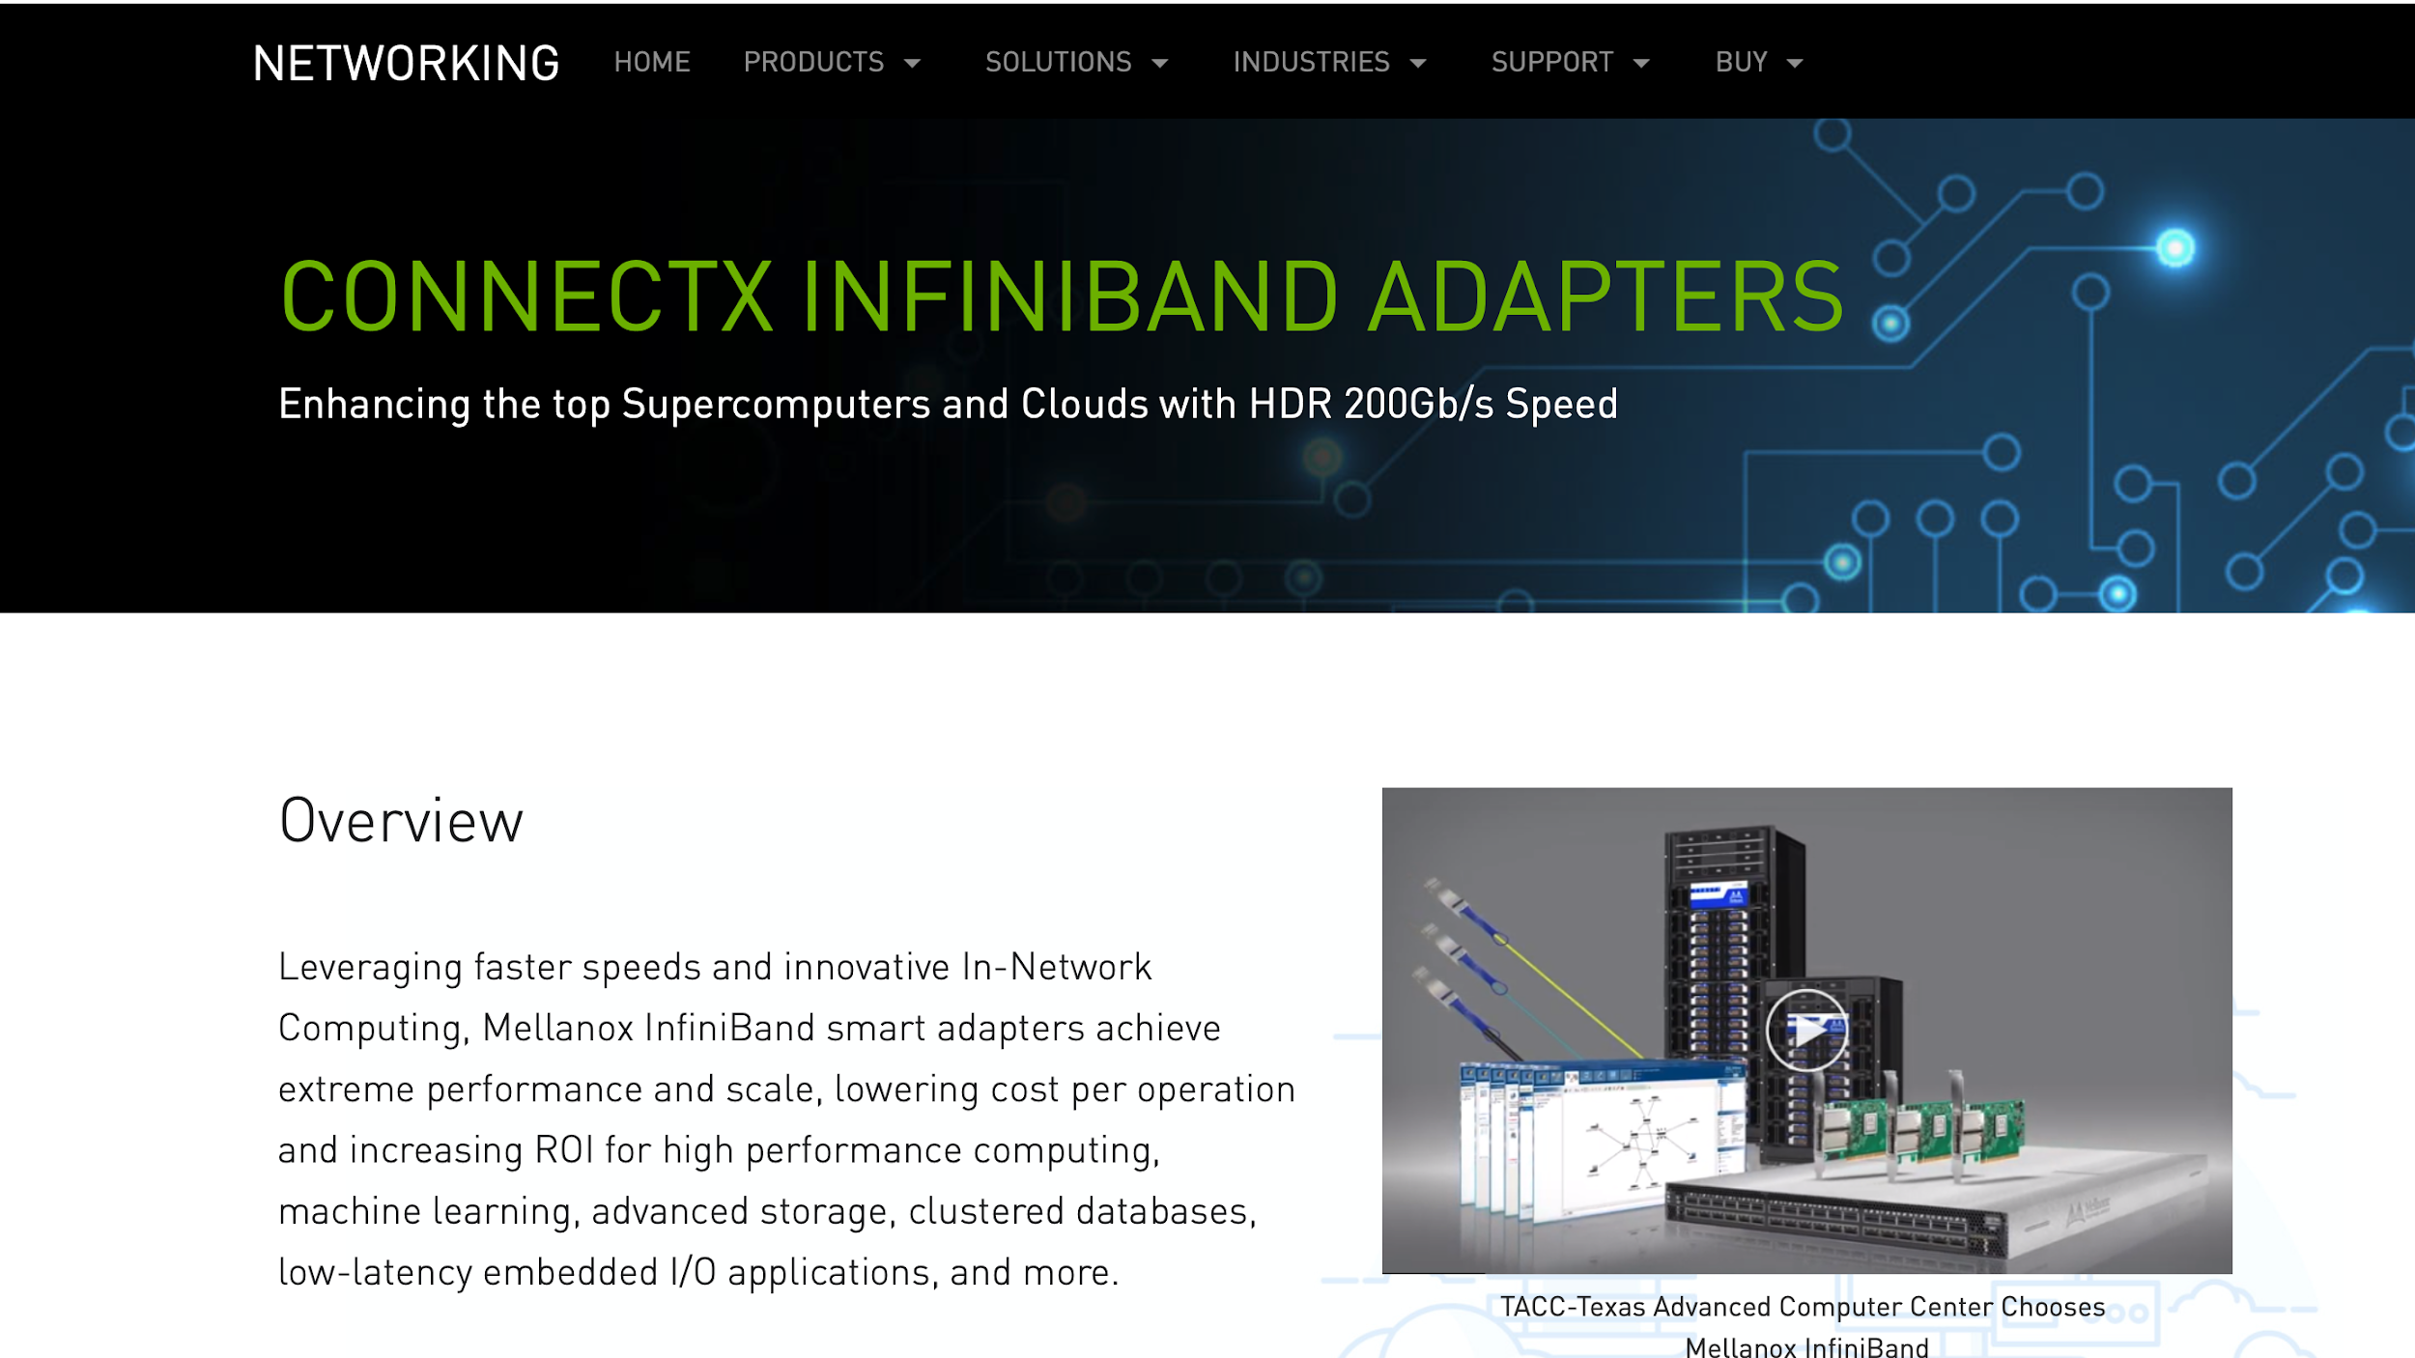
New Wave of Key-Value Stores
Use Kernel-Bypass to leverage High Speed Networks
Hardware accelerated transport. Ex: Mellanox Infiniband, Project Catapult, SmartNICs etc.
Transport integrated into application. Ex: DPDK, RDMA etc.
MICA(NSDI’14) , FaRM (NSDI’14, SOSP’15), KVDirect (SOSP’17) etc
Low-Latency (10s of microseconds per request), High throughput (Million reqs/s)
Notes:
Deployed at scale, can go and allocate an RDMA VM or regular VM with transport offload

Slide 14
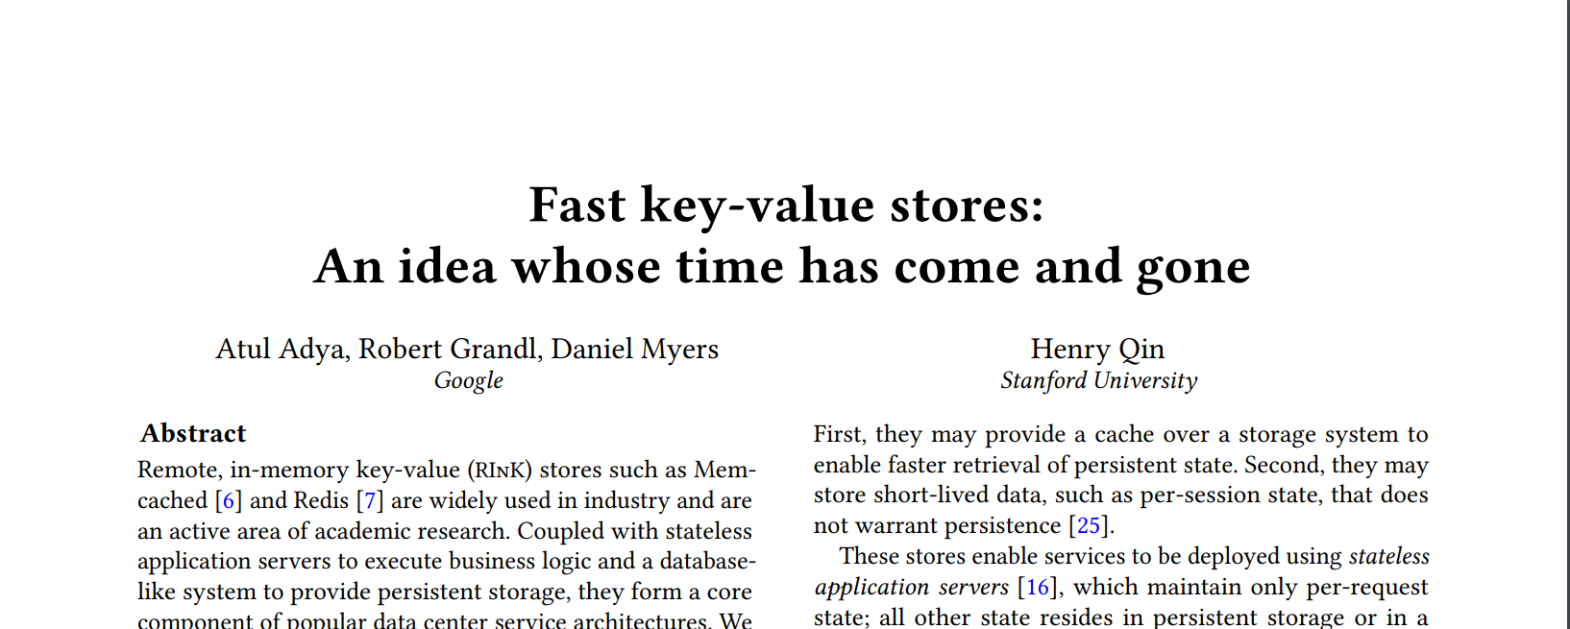
New Wave of (Impractical) Key-Value Stores
Stripped down design to maximize normal case performance:
Reconfiguration? Rich Data models? Multi-tenancy?
Supporting the above can cut into normal-case performance. Ex: Record ownership checks
HotOS 2019
My thesis: Mechanisms for reconfiguration, rich data models and multi-tenancy without compromising on performance

Slide 15
Thesis Contributions
Fast Data Migration with Low Latency Impact [Rocksteady, SOSP’17]:
Enables quick reconfiguration in response to load imbalances, changes in access patterns etc
Low-cost Coordination for Requests Dispatch and Migration [Shadowfax, VLDB’21(Revision)]:
Enables 8x higher throughput on cloud VMs without stalls and cross-core coordination
Extensibility and Multi-tenancy without Hardware Isolation [Splinter, OSDI’18]:
Enables diverse data models by allowing tenants to push functions to the store at runtime

Slide 16
Thesis Statement
Low-latency stores adopt stripped down designs that optimize for the normal case, trading off features that would make them more practical.
My thesis shows that this trade off is unnecessary.
Carefully leveraging and extending abstractions for scheduling, data sharing, lock-freedom, and isolation will yield feature-rich systems that retain their performance.

Slide 17
Fast Data Migration
Chinmay Kulkarni, Aniraj Kesavan, Tian Zhang, Robert Ricci, and Ryan Stutsman. Rocksteady: Fast Migration for Low-latency In-memory Storage. In Proceedings of the Twenty-Sixth ACM Symposium on Operating Systems Principles, SOSP’17
Chinmay Kulkarni, Aniraj Kesavan, Robert Ricci, and Ryan Stutsman. Beyond Simple Request Processing with RAMCloud. IEEE Data Engineering Bulletin, IEEE DEB 40(1) (March 2017)

Slide 18
Rocksteady Introduction
Distributed low-latency in-memory key-value stores are emerging
Predictable response times ~10 µs median, ~60 µs 99.9th-tile
Problem: Must migrate data between servers
Quickly respond to hot spots, skew shifts, load spikes
Minimize performance impact of migration
Solution: Fast data migration with low latency impact
Early ownership transfer of data, leverage workload skew
Low priority, parallel and adaptive migration
Result: Migration protocol for RAMCloud in-memory key-value store
Migrates 6x faster than the baseline
Notes:
Very dense
Why tail latency matters? (multi-tiered applications => lower tiers have tighter SLAs, higher fan-out)

Slide 19
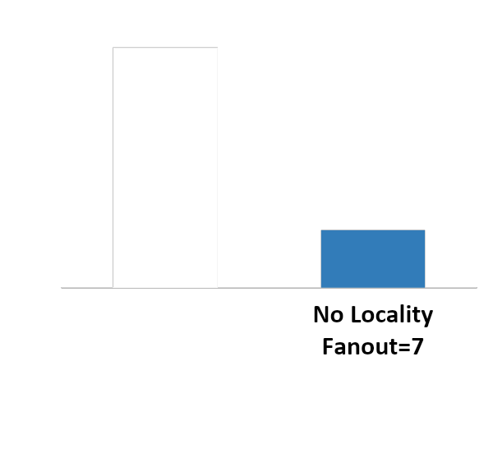
Why Migrate Data?
Poor spatial locality → High multiGet() fan-out → More RPCs
Client 1
Client 2
A
B
C
D
multiGet( )
multiGet( )
6 Million
Server 1
Server 2
A
C
B
D

Slide 20
Migrate To Improve Spatial Locality
Client 1
Client 2
A
B
C
D
multiGet( )
multiGet( )
6 Million
Server 1
Server 2
A
C
B
B
D
C

Slide 21
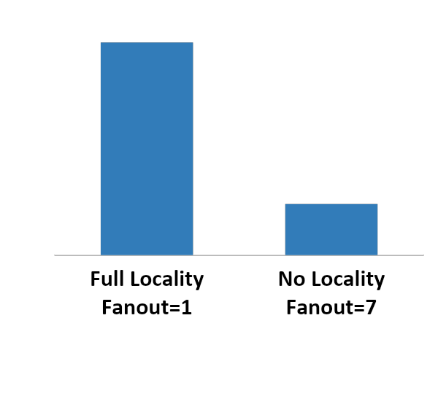
Spatial Locality Improves Throughput
Client 1
Client 2
25 Million
Better spatial locality → Fewer RPCs → Higher throughput
Benefits multiGet(), range scans
A
B
C
D
multiGet( )
multiGet( )
6 Million
Server 1
Server 2
A
B
C
D

Slide 22
Performance Goals For Migration
Migrate data fast
Workloads dynamic → Respond quickly
Maintain low access latency
10 µsec median latency → System extremely sensitive
Tail latency matters at scale → Even more sensitive
Notes:
Flip the order on the two bullets

Slide 23
Rocksteady: Design
Source Server
Target Server
Hash Range
Instantaneous ownership transfer
Immediate load reduction at overloaded source
Creates “headroom” for migration work
Leverage skew to rapidly migrate hot data
Most workloads are skewed, Target comes up to speed with little data movement
Adaptive parallel, pipelined at source and target
All cores avoid stalls, but yield to client-facing operations
Safely defer replication at target
Eliminates replication bottleneck and contention

Slide 24
Rocksteady: Early Ownership Transfer
Problem: Loaded source can bottleneck migration
Solution: Instantly shift ownership and all load to target before shifting data
Client 1
Client 2
Client 3
Client 4
Reads and Writes
Source Server
Target Server
Notes:
What is ownership? Target responsible for finding records, sequencing operations, recovering
Ownership is transferred before the data.

Slide 25
Rocksteady: Early Ownership Transfer
Problem: Loaded source can bottleneck migration
Solution: Instantly shift ownership and all load to target before shifting data
Client 1
Client 2
Client 3
Client 4
Source Server
Instantly Redirected
Target Server
All future operations serviced at Target
Creates “headroom” to speed migration
Notes:
Counter-intuitive: On purpose for fast migration

Slide 26
Rocksteady: Leverage Skew
Problem: Data has not arrived at source yet
Solution: On demand migration of unavailable data
Client 1
Client 2
Client 3
Client 4
Read
Source Server
On-demand Pull
Target Server

Slide 27
Rocksteady: Leverage Skew
Problem: Data has not arrived at source yet
Solution: On demand migration of unavailable data
Client 1
Client 2
Client 3
Client 4
Read
Source Server
Target Server
Hot keys move early
Low Impact to Median Latency

Slide 28
Rocksteady: Adaptive and Parallel
Problem: Old single-threaded protocol limited to 130 MB/s
Solution: Pipelined and parallel at source and target
Client 1
Client 2
Client 3
Client 4
Source Server
On-demand Pull
Target Server
Parallel Pulls

Slide 29
Rocksteady: Adaptive and Parallel
Problem: Old single-threaded protocol limited to 130 MB/s
Solution: Pipelined and parallel at source and target
Client 1
Client 2
Client 3
Client 4
Source Server
On-demand Pull
Target Server
Target Driven
Yields to On-demand Pulls
Moves 758 MB/s
Parallel Pulls
Notes:
758 MB/sec => 256 GB in 6 minutes compared to 36 minutes => scale-out!!!

Slide 30
Rocksteady: Eliminate Sync Replication
Problem: Synchronous replication bottleneck at target
Solution: Safely defer replication until after migration
Client 1
Client 2
Client 3
Client 4
Source Server
On-demand Pull
Target Server
Replication
Parallel Pulls

Slide 31
Rocksteady: Eliminate Sync Replication
Problem: Synchronous replication bottleneck at target
Solution: Safely defer replication until after migration
Client 1
Client 2
Client 3
Client 4
Source Server
Target Server
Replication
Notes:
Lineage. Safe crash recovery.

Slide 32
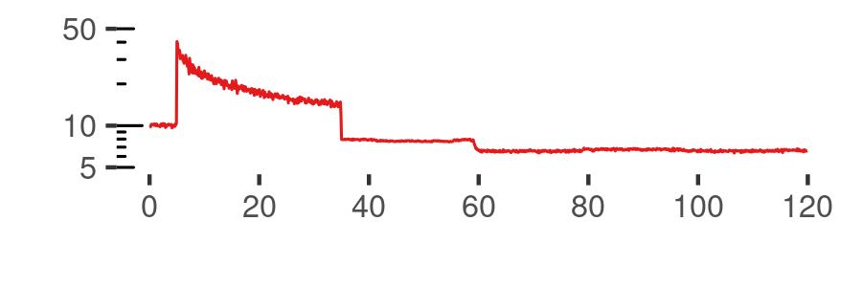
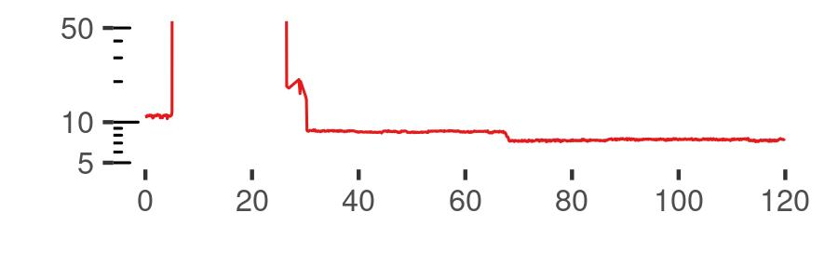
Performance of Rocksteady
YCSB-B, 300 Million objects (30 B key, 100 B value), migrate half
Rocksteady
Median Access Latency (µs)
No Priority Pulls
Time Since Experiment Start (Seconds)

Slide 33
Performance of Rocksteady
YCSB-B, 300 Million objects (30 B key, 100 B value), migrate half
Rocksteady
Median Access Latency (µs)
No Priority Pulls
Time Since Experiment Start (Seconds)
Priority Pulls help maintain Median Latency

Slide 34
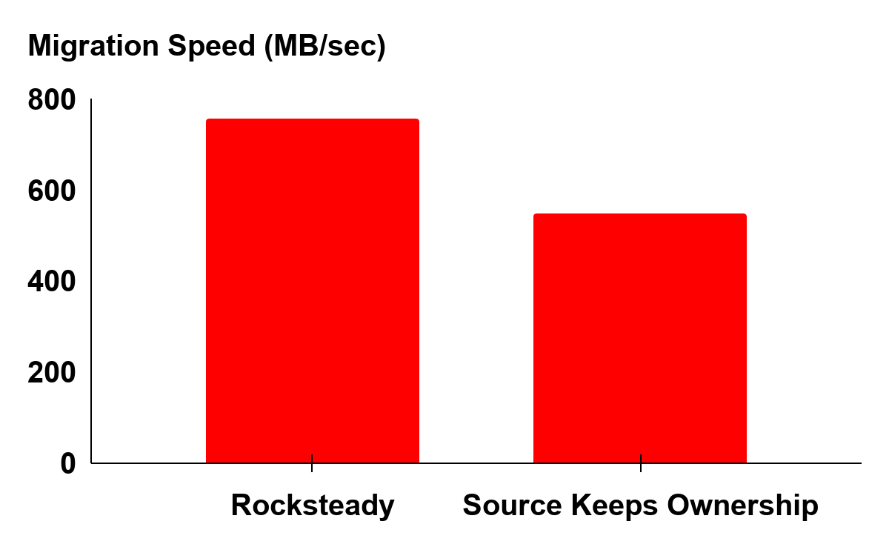
Performance of Rocksteady
YCSB-B, 300 Million objects (30 B key, 100 B value), migrate half
Source headroom speeds up migration by 28%

Slide 35
Rocksteady Conclusion
Distributed low-latency in-memory key-value stores are emerging
Predictable response times ~10 µs median, ~60 µs 99.9th-tile
Problem: Must migrate data between servers
Quickly respond to hot spots, skew shifts, load spikes
Minimize performance impact of migration
Solution: Fast data migration with low latency impact
Early ownership transfer of data, leverage workload skew
Low priority, parallel and adaptive migration
Result: Migration protocol for RAMCloud in-memory key-value store
Migrates 28% faster than the baseline

Slide 36
Low-Cost Coordination
Chinmay Kulkarni, Badrish Chandramouli, and Ryan Stutsman. Achieving High Throughput and Elasticity in a Larger-than-Memory Store. Under Revision at VLDB 2021

Slide 37
Shadowfax Introduction
Multi-core optimized single-node key-value stores are emerging
Very high throughput ~100 Million events/sec/server. Ex: FASTER (SIGMOD’18)
Problem: Retain high throughput in the public cloud
Avoid request dispatch and network bottlenecks → Saturate servers within hash index
Support reconfiguration/migration while preserving throughput
Solution: Partitioned Request Dispatch, Asynchronous Global Cuts
Cores share FASTER index, request dispatch layer is partitioned → retain high throughput
Cores avoid coordination during migration → maintain high throughput
Shadowfax: High Throughput, Elastic, Larger-than-Memory key-value store
100 Million events/sec/VM on Azure, 80 Million events/sec/VM during migration
Spans DRAM, SSD and Cloud blob storage

Slide 38
Seastar: State-of-the-art Cloud Key-Value Store
Server VM
vCPU
NIC
Cloud
Network

Slide 39
Seastar: Records Partitioned Across Cores
Server VM
Hash partition records across vCPUs
Avoids synchronization on records
vCPU
NIC
Cloud
Network

Slide 40
Seastar: Records Partitioned Across Cores
Server VM
Dispatcher on every vCPU
Each listens on different TCP port
Request
Dispatch
vCPU
NIC
Cloud
Network

Slide 41
Seastar: Requests Routed Within Server
Server VM
Each dispatcher routes requests to correct partition
Request
Dispatch
vCPU
NIC
Cloud
Network

Slide 42
Seastar: Shuffling Requests Limits Scalability
Server VM
Each dispatcher routes requests to correct partition
Expensive shuffle!
Request
Dispatch
vCPU
NIC
Cloud
Network

Slide 43

Seastar: Shuffling Requests Limits Scalability
Server VM
Doesn’t scale across vCPUs
Request
Dispatch
vCPU
NIC
Cloud
Network

Slide 44
Seastar: Clients Could Route Requests Correctly
Server VM
Clients could route to correct core/owner
Quadratic connection state!
(client cores*server cores)
OR
Shuffle requests at client
Request
Dispatch
vCPU
NIC
Cloud
Network

Slide 45
Seastar: Bad For Skewed Workloads
Server VM
Bad for skewed workloads
Request
Dispatch
Under-utilized
vCPU
NIC
Cloud
Network

Slide 46
Seastar: Migration Has To Be Single Threaded
Server VM
Migration cannot be parallelized
Migration Task
Request
Dispatch
vCPU
NIC
Cloud
Network

Slide 47
Seastar: Head-of-line Blocking During Migration
Server VM
Migration blocks requests on partition
Migration Task
Request
Dispatch
vCPU
NIC
Cloud
Network

Slide 48
Shadowfax: Design
Partitioned Request Dispatch, Shared Data
vCPUs share lock-free index → record synchronization handled by cache coherence
Migration can be parallelized, does not block requests on hash ranges
End-to-End Asynchronous Clients
Issue pipelined asynchronous batches of requests to amortize network overhead
Good for workloads with inter-request independence. Ex: click counts, heartbeats etc.
Asynchronous Global Cuts
Per server view numbers represent hash ranges owned by server
Cores avoid coordination during migration ownership changes

Slide 49
Shadowfax: Partitioned Request Dispatch Shared Data
Problem: Avoid cross-core coordination at server
Solution: Offload all coordination to hardware cache-coherence protocol
Server VM
Shared memory is good for skew
Can serve hot records in parallel
vCPU
NIC
Cloud
Network

Slide 50
Shadowfax: Partitioned Request Dispatch Shared Data
Problem: Avoid cross-core coordination at server
Solution: Offload all coordination to hardware cache-coherence protocol
Server VM
FASTER
Key-Value Store
Lock-free index
Record synch happens at cache-coherence protocol (hw)
vCPU
NIC
Cloud
Network

Slide 51
Shadowfax: Partitioned Request Dispatch Shared Data
Problem: Multi-core request processing requires cross-core coordination
Solution: Offload all coordination to hardware cache-coherence protocol
Server VM
FASTER
Key-Value Store
Partition request dispatch
Each dispatcher listens on separate TCP port
Request
Dispatcher
vCPU
NIC
Cloud
Network

Slide 52
Shadowfax: Partitioned Request Dispatch Shared Data
Problem: Keep servers saturated at index, not network or dispatch
Solution: Asynchronous client library, transparent network acceleration
Server VM
Client VM
FASTER
Key-Value Store
Application
vCPU
NIC
Cloud
Network
NIC

Slide 53
Shadowfax: Partitioned Request Dispatch Shared Data
Problem: Keep servers saturated at index, not network or dispatch
Solution: Asynchronous client library, transparent network acceleration
Server VM
Client VM
FASTER
Key-Value Store
Application
Library
Client cores open “sessions” to server cores
Sessions
vCPU
Notes:
Show one-one vCPU mapping (Connect client vCPU to server vCPU directly using curved arrows)
Any client thread can generate a request for any record inside FASTER. No shuffle!!

Slide 54
Shadowfax: Partitioned Request Dispatch Shared Data
Problem: Keep servers saturated at index, not network or dispatch
Solution: Asynchronous client library, transparent network acceleration
Server VM
Client VM
Requests are async
Enqueued inside session buffers
FASTER
Key-Value Store
Application
Library
Sessions
vCPU

Slide 55
Shadowfax: Partitioned Request Dispatch Shared Data
Problem: Keep servers saturated at index, not network or dispatch
Solution: Asynchronous client library, transparent network acceleration
Server VM
Client VM
FASTER
Key-Value Store
Application
Library
Pipelined batches are transmitted asynchronously
Sessions
vCPU
Notes:
On Azure. Our approach is good with accelerated networking!

Slide 56
Shadowfax: Partitioned Request Dispatch Shared Data
Problem: Keep servers saturated at index, not network or dispatch
Solution: Asynchronous client library, transparent network acceleration
Server VM
Client VM
FASTER
Key-Value Store
Application
Library
Pipelined batches are transmitted asynchronously
Request
Request
Batches
Sessions
vCPU
Notes:
On Azure. Our approach is good with accelerated networking!

Slide 57
Shadowfax: Transparent Cloud Acceleration
Problem: Keep servers saturated at index, not network or dispatch
Solution: Asynchronous client library, transparent network acceleration
Server VM
Client VM
FASTER
Key-Value Store
Application
Hardware accelerated transport (TCP & Infrc)
Library
Request
Request
Batches
Sessions
vCPU
Smart NIC
Cloud
Network
Smart NIC
Notes:
On Azure. Our approach is good with accelerated networking!

Slide 58
Shadowfax: Asynchronous Global Cuts
Problem: Avoid cross-core coordination during migration
Solution: Server and client cores observe ownership change independently
Shared Memory FASTER Key-Value Store
Migration changes server’s ownership
“View” change
Op
Op
Op
Core
Notes:
No one enforces the cut. The cut is in hindsight. Build this figure up(?)
We don’t want to sequence operations anywhere at the server or client. Sequencing operations => pause performance, serial bottleneck.
No serial bottleneck!
Push cut to client to help it scale better (server’s don’t need to perform any range checks?)

Slide 59
Shadowfax: Asynchronous Global Cuts
Problem: Avoid cross-core coordination during migration
Solution: Server and client cores observe ownership change independently
Shared Memory FASTER Key-Value Store
Operations after view change must be retransmitted to new owner
Op
Op
view change
Op
Core
Notes:
No one enforces the cut. The cut is in hindsight. Build this figure up(?)
We don’t want to sequence operations anywhere at the server or client. Sequencing operations => pause performance, serial bottleneck.
No serial bottleneck!
Push cut to client to help it scale better (server’s don’t need to perform any range checks?)

Slide 60
Shadowfax: Asynchronous Global Cuts
Problem: Avoid cross-core coordination during migration
Solution: Server and client cores observe ownership change independently
Shared Memory FASTER Key-Value Store
View change can become a serial bottleneck
Op
Op
Op
Op
Op
Op
Op
Op
Serial bottleneck
(Barrier)
Op
Op
Op
Op
Core
Core
Core
Core
Notes:
No one enforces the cut. The cut is in hindsight. Build this figure up(?)
We don’t want to sequence operations anywhere at the server or client. Sequencing operations => pause performance, serial bottleneck.
No serial bottleneck!
Push cut to client to help it scale better (server’s don’t need to perform any range checks?)

Slide 61
Shadowfax: Asynchronous Global Cuts
Problem: Avoid cross-core coordination during migration
Solution: Server and client cores observe ownership change independently
Shared Memory FASTER Key-Value Store
Old view → New view
Each core
observes change independently
Op
Op
Op
Op
Old view
Op
Op
Op
Op
“Async cut” avoids coordination within server
New view
Op
Op
Op
Op
Core
Core
Core
Core
Notes:
No one enforces the cut. The cut is in hindsight. Build this figure up(?)
We don’t want to sequence operations anywhere at the server or client. Sequencing operations => pause performance, serial bottleneck.
No serial bottleneck!
Push cut to client to help it scale better (server’s don’t need to perform any range checks?)

Slide 62
Shadowfax: Asynchronous Global Cuts
Problem: Avoid cross-core coordination during migration
Solution: Server and client cores observe ownership change independently
Server
Async cut becomes “global cut” across sessions
Sessions
Global Cut
vCPU

Slide 63
Shadowfax: Asynchronous Global Cuts
Problem: Avoid cross-core coordination during migration
Solution: Server and client cores observe ownership change independently
Client
Client
Global cut pushed to clients
Avoids coordination at clients
Clients reissue operations
Server
Sessions
Global Cut
vCPU
Notes:
Why do clients care about the cut?
Reissue requests to the new owner!

Slide 64
Shadowfax: Indirection Records
Problem: Migrating records on SSD can slow down reconfiguration
Solution: Use shared remote tier to restrict migration to main memory
Hash Table
SSD
Main Memory
HybridLog

Slide 65
Shadowfax: Indirection Records
Problem: Migrating records on SSD can slow down reconfiguration
Solution: Use shared remote tier to restrict migration to main memory
Hash Table
Records on SSD are also flushed to remote cloud blob storage
Remote Blob Store
SSD
Main Memory
Network
HybridLog

Slide 66
Shadowfax: Indirection Records
Problem: Migrating records on SSD can slow down reconfiguration
Solution: Use shared remote tier to restrict migration to main memory
Server-1
Server-2
Migration
Migrate pointers to shared layer
Lazily cleaned up
Dependencies
Shared Remote Blob Store
Server-1 Log
Server-2 Log
Notes:
Show source and target! Avoid this diagram?

Slide 67
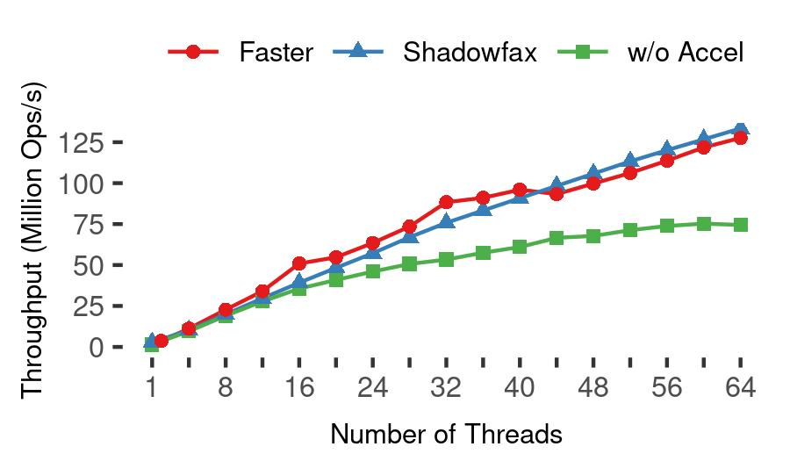
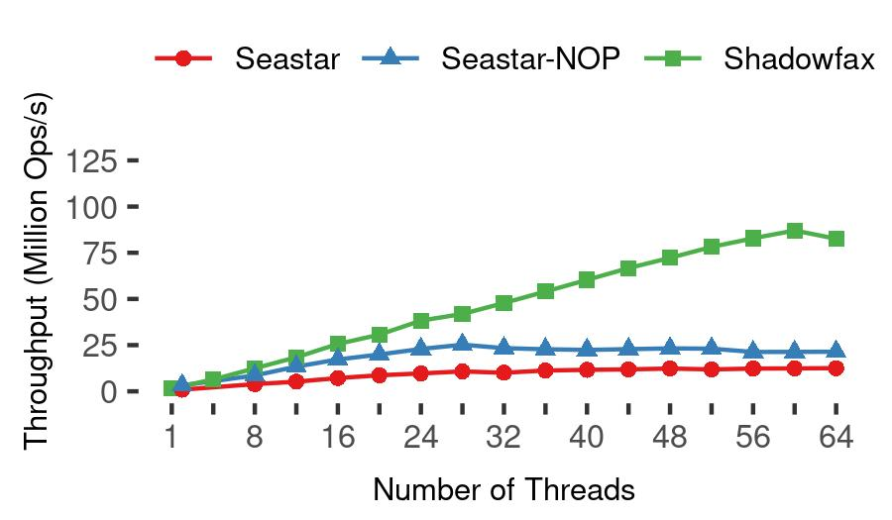
Performance of Shadowfax
YCSB-F (Read-Modify-Writes, Benchmark Ingest of Events), 250 Million objects
Saturates server at Index, 8.5x state-of-the-art

Slide 68
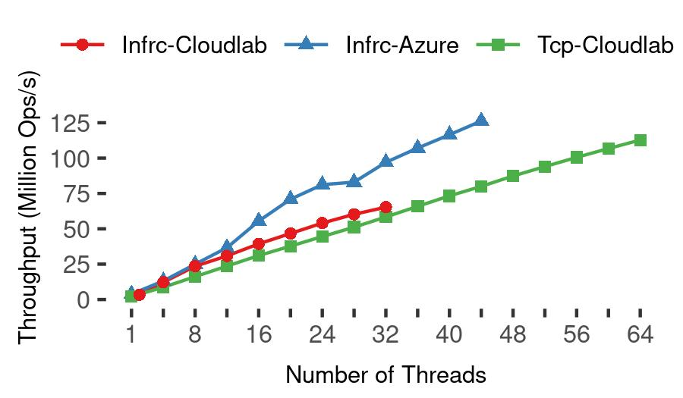
Performance of Shadowfax
YCSB-F (Read-Modify-Writes, Benchmark Ingest of Events), 250 Million objects
Reproducible on different hardware platforms (Intel and AMD)

Slide 69
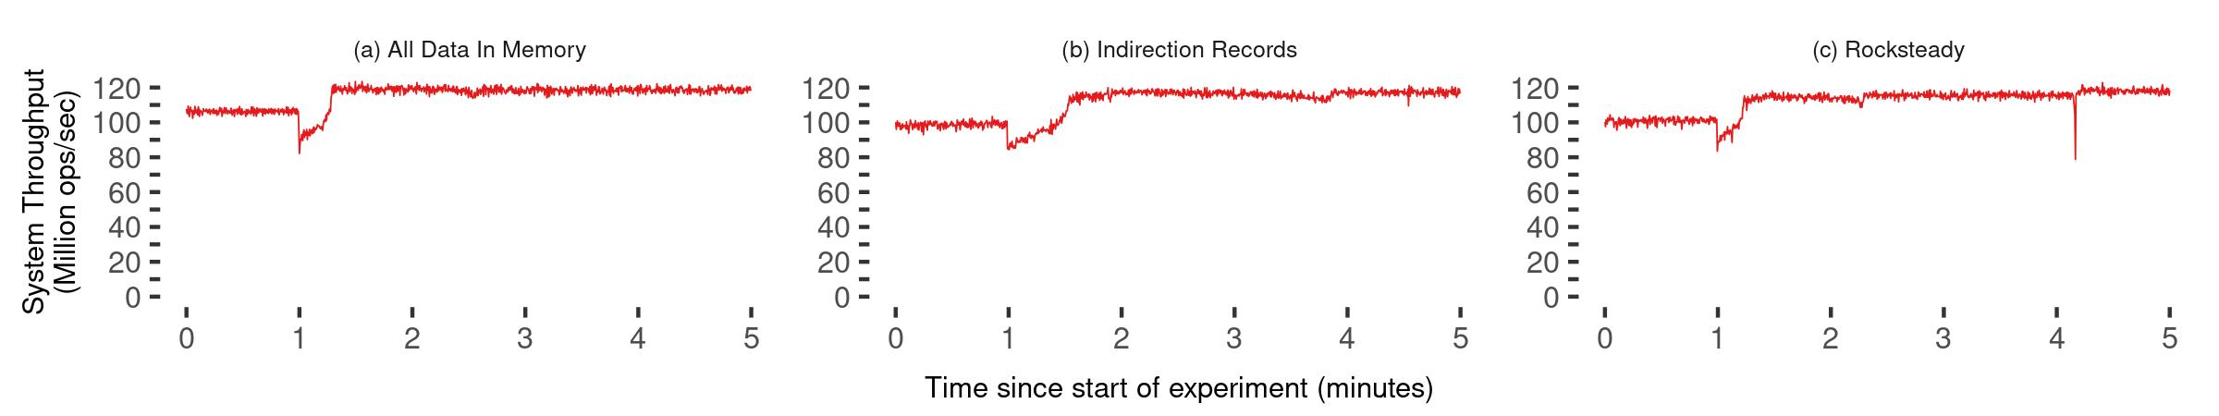
Performance of Shadowfax
YCSB-F (Read-Modify-Writes), 250 Million objects, Migrate 10%
Throughput maintained > 80 Million events/second

Slide 70
Performance of Shadowfax
YCSB-F (Read-Modify-Writes), 250 Million objects, Migrate 10%
Migrating
records on SSD
Indirection records complete migration 6x faster
Notes:
Connect to Rocksteady’s lineage

Slide 71
Shadowfax Conclusion
Multi-core optimized single-node key-value stores are emerging
Very high throughput ~100 Million events/sec/server. Ex: FASTER (SIGMOD’18)
Problem: Retain high throughput in the public cloud
Avoid dispatch and network bottlenecks → Saturate servers within hash index
Support reconfiguration/migration while preserving throughput
Solution: Partitioned Request Dispatch, Asynchronous Global Cuts
Cores share FASTER index, dispatch layer is partitioned → retain high throughput
Cores avoid coordination during migration → maintain high throughput
Shadowfax: High Throughput, Elastic, Larger-than-Memory key-value store
100 Million events/sec/VM on Azure, 80 Million events/sec/VM during migration
Spans DRAM, SSD and Cloud blob storage

Slide 72
Extensibility and Multi-tenancy
Chinmay Kulkarni, Sara Moore, Mazhar Naqvi, Tian Zhang, Robert Ricci, and Ryan Stutsman. Splinter: Bare-Metal Extensions for Multi-Tenant Low-Latency Storage. In Proceedings of the 13th USENIX Symposium on Operating Systems Design and Implementation, OSDI’18
Ankit Bhardwaj, Chinmay Kulkarni, and Ryan Stutsman. Adaptive Placement for In-memory Storage Functions. In Proceedings of the 2020 USENIX Annual Technical Conference, ATC’20

Slide 73
Splinter Introduction
Kernel-bypass key-value stores offer < 10μs latency, > Mops/s throughput
Fast because they support just simple gets and puts?
Problem: Leverage performance → share between tenants
Problem: Apps require rich data models. Ex: Facebook’s TAO
Implement using gets & puts? → Data movement, client stalls
Push code to key-value store? → Isolation costs limit density
Splinter: Multi-tenant key-value store that code can be pushed to
Tenants push type- & memory-safe code written in Rust at runtime
Aggregate workload improves by 2x, Facebook’s TAO by 400 Kops/s
Notes:
Just simple gets and puts

Slide 74
Richer Data Models Come At A Price
get_friends(user)
Client
Apps require rich data models in addition to performance
Ex: Social graphs, Decision trees etc
get()/put()
Key-value store
Hash Table
Records
Key-value stores trade-off data model for performance
Simple get()’s & put()’s over key-value pairs
Thinner data model → Better performance
But do applications benefit?

Slide 75
Richer Data Models Come At A Price
get_friends(user)
Client
Apps require rich data models in addition to performance
Ex: Social graphs, Decision trees etc
get()/put()
Key-value store
Hash Table
Records
Key-value stores trade-off data model for performance
Simple get()’s & put()’s over key-value pairs
Thinner data model → Better performance
But do applications benefit?
Thinner data model → Better performance
But do applications benefit?

Slide 76
Extra Round-Trips (RTTs) Hurt Latency & Utilization
Client
Example: Traverse tree with N nodes using gets
One get() at each level of the tree → O(log N) RTTs
Control flow depends on data → Client stalls during get()
get()/put()
Key-value store
Hash Table
Records
Network RTTs, dispatch are the main bottleneck ~10μs
1.5μs inside the server
So push code to storage?

Slide 77
Extra Round-Trips (RTTs) Hurt Latency & Utilization
Client
Example: Traverse tree with N nodes using gets
One get() at each level of the tree → O(log N) RTTs
Control flow depends on data → Client stalls during get()
get()/put()
Key-value store
Hash Table
Records
Network RTTs, dispatch are the main bottleneck ~10μs
1.5μs inside the server
So push code to storage?
So push code to storage?

Slide 78
Why Not Push Compute To Storage?
fn get_friends() {
….
….
….
}
fn get_friends() {
….
….
….
}
fn get_friends() {
….
….
….
}
fn get_friends() {
….
….
….
}
fn get_friends() {
….
….
….
}
fn get_friends() {
….
….
….
}
fn get_friends() {
….
….
….
}
fn get_friends() {
….
….
….
}
fn get_friends() {
….
….
….
}
fn get_friends() {
….
….
….
}
fn get_friends() {
….
….
….
}
fn get_friends() {
….
….
….
}
fn get_friends() {
….
….
….
}
fn get_friends() {
….
….
….
}
RPC Processing Time ~1.5µs
Only native code will do
fn get_friends() {
….
….
….
}
fn classify() {
….
….
}
ISOLATION?
Key-value store
Context Switches ~1.5µs
Multi-tenancy → Need hardware isolation
Notes:
Ex: SQL parsing, query planning >> 1.5 useconds

Slide 79
What Do We Want From The Storage Layer?
Granularity of compute is steadily decreasing
Virtual machines → Containers → Lambdas
Extremely high tenant density
Fine-grained resource allocation; 100s of CPU cycles, Kilobytes of memory
Allow tenants to extend data model at runtime
Low overhead isolation between tenants & storage layer

Slide 80
Splinter: A Multi-Tenant Key-Value Store
Tenants can install and invoke extensions at runtime
Extensions written in Rust
Rely on type and memory safety for isolation, avoids context switch
Implemented in ~9000 lines of Rust
Supports two RPCs → install(ext_name) & invoke(ext_name)
Also supports regular get() & put() RPCs → “Native” operations

Slide 81
1000 Foot View Of Splinter
Tenants
Splinter
rustc
rustc
rustc
Tenant Hash Tables

Slide 82
1000 Foot View Of Splinter
Tenants
Tenants push extensions
written in Rust
Splinter
rustc
rustc
rustc
rustc
rustc
rustc
Splinter
loads extensions
Into address-space
Tenant Hash Tables

Slide 83
1000 Foot View Of Splinter
Tenants
Splinter
rustc
rustc
rustc
rustc
rustc
rustc
Rust provides
memory-safety
Rust provides
memory-safety
Extensions do not
share state
Extensions do not
share state
Tenant Hash Tables

Slide 84
1000 Foot View Of Splinter
Tenants
Splinter
rustc
rustc
rustc
rustc
rustc
rustc
Extensions receive
references to records
Each tenant sees
a custom key-value store
Tenant Hash Tables

Slide 85
Splinter: Design
Low cost isolation
No forced data copies across trust boundary
Tenant Locality And Work Stealing
Avoid cross-core coordination while avoiding hotspots
Lightweight Cooperative Scheduling
Prevent long running extensions from starving short running ones

Slide 86
Splinter: Low Cost Isolation
Problem: No forced data copies across trust boundary
Solution: Ensure buffers outlast reference lifetime
aggregate() → u64 {
…
…
}
Request Buffer
Send references
to extension
Response Buffer

Slide 87
Splinter: Low Cost Isolation
Problem: No forced data copies across trust boundary
Solution: Ensure buffers outlast reference lifetime
aggregate() → u64 {
…
…
}
Refs
Request Buffer
Send references
to extension
Response Buffer

Slide 88
Splinter: Low Cost Isolation
Problem: No forced data copies across trust boundary
Solution: Ensure buffers outlast reference lifetime
Statically ensure
record stays
stable across yields
aggregate() → u64 {
…
…
}
Refs
Request Buffer
Lifetime
Statically ensure
RPC buffers
outlast lifetime
Response Buffer

Slide 89
Splinter: Low Cost Isolation
Problem: No forced data copies across trust boundary
Solution: Ensure buffers outlast reference lifetime
aggregate() → u64 {
…
yield;
}
Refs
Statically ensure
record stays
stable across yields
Lifetime
Record

Slide 90
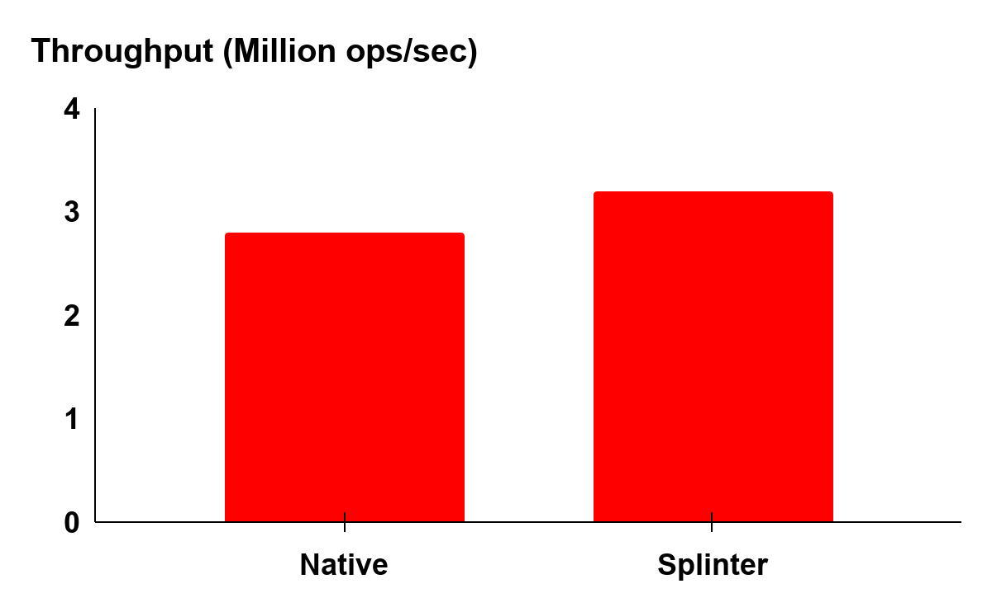
Pushing Facebook’s TAO To Splinter
Hybrid → get() for point ops, extension for dependencies
Best of both worlds!
Notes:
Remove Extension. Replace “Hybrid” with “Splinter”
Large data dependence -> better improvements (2x with aggregate)
When Native? When Splinter?

Slide 91
Splinter Conclusion
Kernel-bypass key-value stores offer < 10μs latency, > Mops/s throughput
Fast because they support just simple gets and puts?
Problem: Leverage performance → share between tenants
Problem: Apps require rich data models. Ex: Facebook’s TAO
Implement using gets & puts? → Data movement, client stalls
Push code to key-value store? → Isolation costs limit density
Splinter: Multi-tenant key-value store that code can be pushed to
Tenants push type- & memory-safe code written in Rust at runtime
Aggregate workload improves by 2x, Facebook’s TAO by 400 Kops/s
Notes:
Just simple gets and puts

Slide 92
Thesis Contributions
Fast Data Migration with Low Latency Impact [Rocksteady, SOSP’17]
Low-cost Coordination for Request Dispatch and Migration [Shadowfax, VLDB’21, Revision]
Extensibility and Multi-tenancy without Hardware Isolation [Splinter, OSDI’18]
Low-latency stores adopt simple, stripped down designs that optimize for normal case performance, and in the process, trade off features that would make them more practical and cost effective at cloud scale. This thesis shows that this trade off is unnecessary. Carefully leveraging and extending new and existing abstractions for scheduling, data sharing, lock-freedom, and isolation will yield feature-rich systems that retain their primary performance benefits at cloud scale.
Notes:
Arrow after citation -> pick two key ideas? Draw arrows connecting contributions and adjectives in the thesis statement

Slide 93
Thesis Contributions
Fast Data Migration with Low Latency Impact [Rocksteady, SOSP’17]
Low-cost Coordination for Request Dispatch and Migration [Shadowfax, VLDB’21, Revision]
Extensibility and Multi-tenancy without Hardware Isolation [Splinter, OSDI’18]
Create headroom
On-demand migration of hot keys
Low-latency stores adopt simple, stripped down designs that optimize for normal case performance, and in the process, trade off features that would make them more practical and cost effective at cloud scale. This thesis shows that this trade off is unnecessary. Carefully leveraging and extending new and existing abstractions for scheduling, data sharing, lock-freedom, and isolation will yield feature-rich systems that retain their primary performance benefits at cloud scale.
Notes:
Arrow after citation -> pick two key ideas? Draw arrows connecting contributions and adjectives in the thesis statement

Slide 94
Thesis Contributions
Fast Data Migration with Low Latency Impact [Rocksteady, SOSP’17]
Low-cost Coordination for Request Dispatch and Migration [Shadowfax, VLDB’21, Revision]
Extensibility and Multi-tenancy without Hardware Isolation [Splinter, OSDI’18]
Partitioned Dispatch Shared Data
Asynchronous Global Cuts
Low-latency stores adopt simple, stripped down designs that optimize for normal case performance, and in the process, trade off features that would make them more practical and cost effective at cloud scale. This thesis shows that this trade off is unnecessary. Carefully leveraging and extending new and existing abstractions for scheduling, data sharing, lock-freedom, and isolation will yield feature-rich systems that retain their primary performance benefits at cloud scale.
Notes:
Arrow after citation -> pick two key ideas? Draw arrows connecting contributions and adjectives in the thesis statement

Slide 95
Thesis Contributions
Fast Data Migration with Low Latency Impact [Rocksteady, SOSP’17]
Low-cost Coordination for Request Dispatch and Migration [Shadowfax, VLDB’21, Revision]
Extensibility and Multi-tenancy without Hardware Isolation [Splinter, OSDI’18]
Low-cost Isolation
Co-op scheduling
Tenant Locality
Low-latency stores adopt simple, stripped down designs that optimize for normal case performance, and in the process, trade off features that would make them more practical and cost effective at cloud scale. This thesis shows that this trade off is unnecessary. Carefully leveraging and extending new and existing abstractions for scheduling, data sharing, lock-freedom, and isolation will yield feature-rich systems that retain their primary performance benefits at cloud scale.
Notes:
Arrow after citation -> pick two key ideas? Draw arrows connecting contributions and adjectives in the thesis statement

Slide 96
Thesis Contributions
Fast Data Migration with Low Latency Impact [Rocksteady, SOSP’17]
Low-cost Coordination for Request Dispatch and Migration [Shadowfax, VLDB’21, Revision]
Extensibility and Multi-tenancy without Hardware Isolation [Splinter, OSDI’18]
Low-latency stores adopt simple, stripped down designs that optimize for normal case performance, and in the process, trade off features that would make them more practical and cost effective at cloud scale. This thesis shows that this trade off is unnecessary. Carefully leveraging and extending new and existing abstractions for scheduling, data sharing, lock-freedom, and isolation will yield feature-rich systems that retain their primary performance benefits at cloud scale.
Notes:
Arrow after citation -> pick two key ideas? Draw arrows connecting contributions and adjectives in the thesis statement

Slide 97
Backup Slides

Slide 98
Splinter: Tenant Locality And Work Stealing
Problem: Quickly dispatch requests to cores, avoid hotspots
Solution: NIC routes tenants to cores, cores steal work
Tenants
Flow Director
NIC
Server
One Rx queue per core

Slide 99
Splinter: Tenant Locality And Work Stealing
Problem: Quickly dispatch requests to cores, avoid hotspots
Solution: NIC routes tenants to cores, cores steal work
Tenants
Flow Director
NIC
Server
NIC Rx Queue
One Rx queue per core

Slide 100
Splinter: Tenant Locality And Work Stealing
Problem: Quickly dispatch requests to cores, avoid hotspots
Solution: NIC routes tenants to cores, cores steal work
Tenants
NIC
Flow Director
NIC
Server
NIC Rx Queue
Maintain “Locality”
route tenant to queue

Slide 101
Splinter: Tenant Locality And Work Stealing
Problem: Quickly dispatch requests to cores, avoid hotspots
Solution: NIC routes tenants to cores, cores steal work
Tenants
NIC
Server
Hotspot
Few active tenants
Many idle tenants

Slide 102
Splinter: Tenant Locality And Work Stealing
Problem: Quickly dispatch requests to cores, avoid hotspots
Solution: NIC routes tenants to cores, cores steal work
Tenants
NIC
Server
Cores steal from
neighboring queue

Slide 103
Splinter: Lightweight Cooperative Scheduling
Problem: Minimize trust boundary crossing cost
Solution: Run extensions in stackless coroutines
NIC Rx Queue
Coroutine
Dedicated Dispatch task
to construct coroutines
Worker Thread
Task Queue

Slide 104
Splinter: Lightweight Cooperative Scheduling
Problem: Minimize trust boundary crossing cost
Solution: Run extensions in stackless coroutines
NIC Rx Queue
Coroutine
Worker Thread
Task Queue

Slide 105
Splinter: Lightweight Cooperative Scheduling
Problem: Minimize trust boundary crossing cost
Solution: Run extensions in stackless coroutines
NIC Rx Queue
Coroutine
Dedicated Dispatch task
to construct coroutines
Worker Thread
Task Queue

Slide 106
Splinter: Lightweight Cooperative Scheduling
Problem: Minimize trust boundary crossing cost
Solution: Run extensions in stackless coroutines
NIC Rx Queue
Task switch cost ~10ns
Coroutine
Dedicated Dispatch task
to construct coroutines
Worker Thread
Task Queue

Slide 107
Splinter: Lightweight Cooperative Scheduling
Problem: Minimize trust boundary crossing cost
Solution: Run extensions in stackless coroutines
NIC Rx Queue
Task switch cost ~10ns
Coroutine
Run extension
until it returns
Worker Thread
Task Queue

Slide 108
Splinter: Lightweight Cooperative Scheduling
Problem: Long running tasks starve shorter tasks, hurt latency
Solution: Extensions are cooperative, must yield frequently
Task switch cost ~10ns
aggregate() → u64 {
……
yield;
…...
}
Preemption is too
expensive!
Running Task
Task Queue

Slide 109
Splinter: Lightweight Cooperative Scheduling
Problem: Long running tasks starve shorter tasks, hurt latency
Solution: Extensions are cooperative, must yield frequently
aggregate() → u64 {
...
yield;
...
}
Compiler generates code
to save & restore state
Running Task
Task Queue

Slide 110
Splinter: Lightweight Cooperative Scheduling
Problem: Uncooperative extensions
Solution: Trusted watchdog core
aggregate() → u64 {
...
loop {};
...
}
Running Task
Task Queue

Slide 111
Splinter: Lightweight Cooperative Scheduling
Problem: Uncooperative extensions
Solution: Trusted watchdog core
Watchdog
Poor Qos
aggregate() → u64 {
……
loop {};
…...
}
Uncooperative Task
Task Queue

Slide 112
Splinter: Lightweight Cooperative Scheduling
Problem: Uncooperative extensions
Solution: Trusted watchdog core
Watchdog
aggregate() → u64 {
……
loop {};
…...
}
Migrate worker thread

Slide 113
Splinter: Lightweight Cooperative Scheduling
Problem: Uncooperative extensions
Solution: Trusted watchdog core
Watchdog
Delete Rx queue
aggregate() → u64 {
……
loop {};
…...
}
Extension cannot
send/recv packets
Spawn new worker thread

Slide 114
Splinter: Lightweight Cooperative Scheduling
Problem: Uncooperative extensions
Solution: Trusted watchdog core
Watchdog
Poor Qos
aggregate() → u64 {
……
loop {};
…...
}
Kill worker thread
when task yields
Steal enqueued tasks

Slide 115
Key-Value Stores are Used Everywhere!

Slide 116
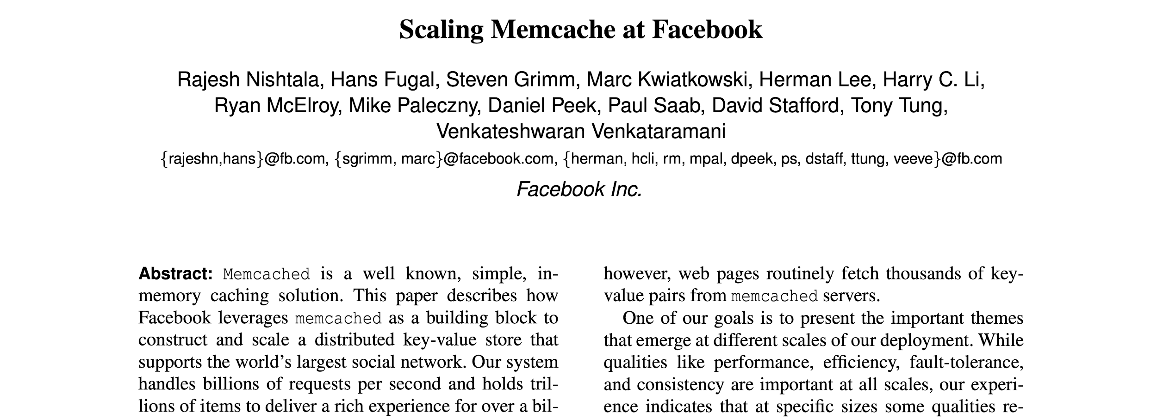
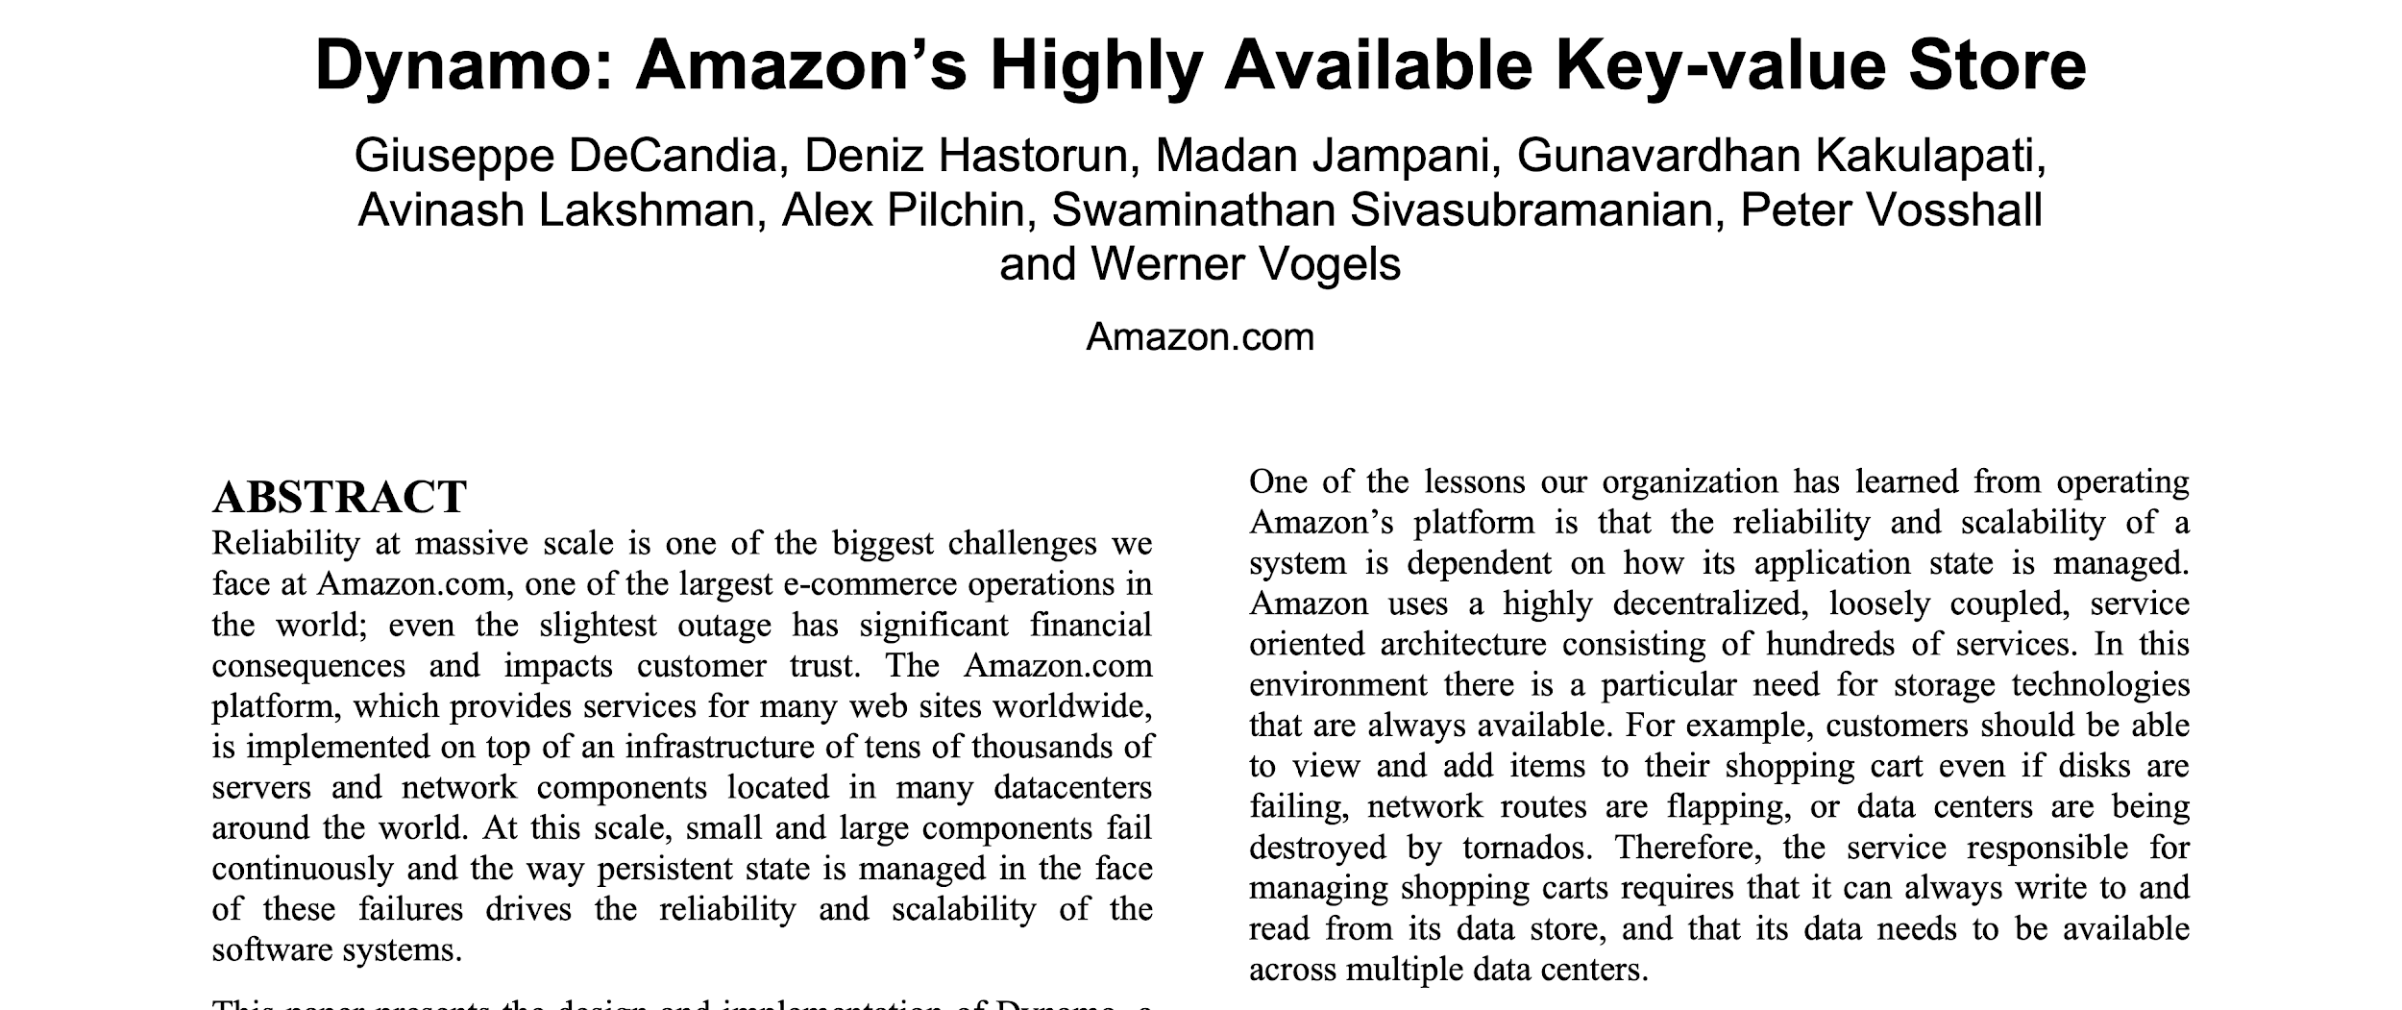
Key-Value Stores are Used Everywhere!
NSDI 2013 SOSP 2007
Notes:
Add more papers to the stack in another slide. People are still optimizing.

Slide 117
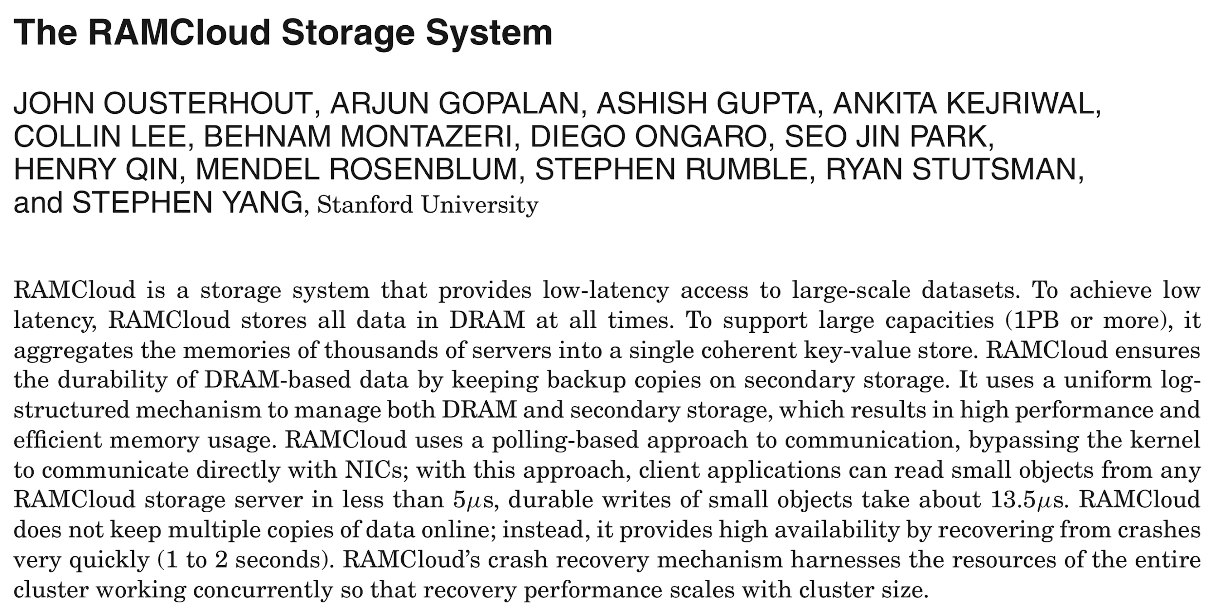
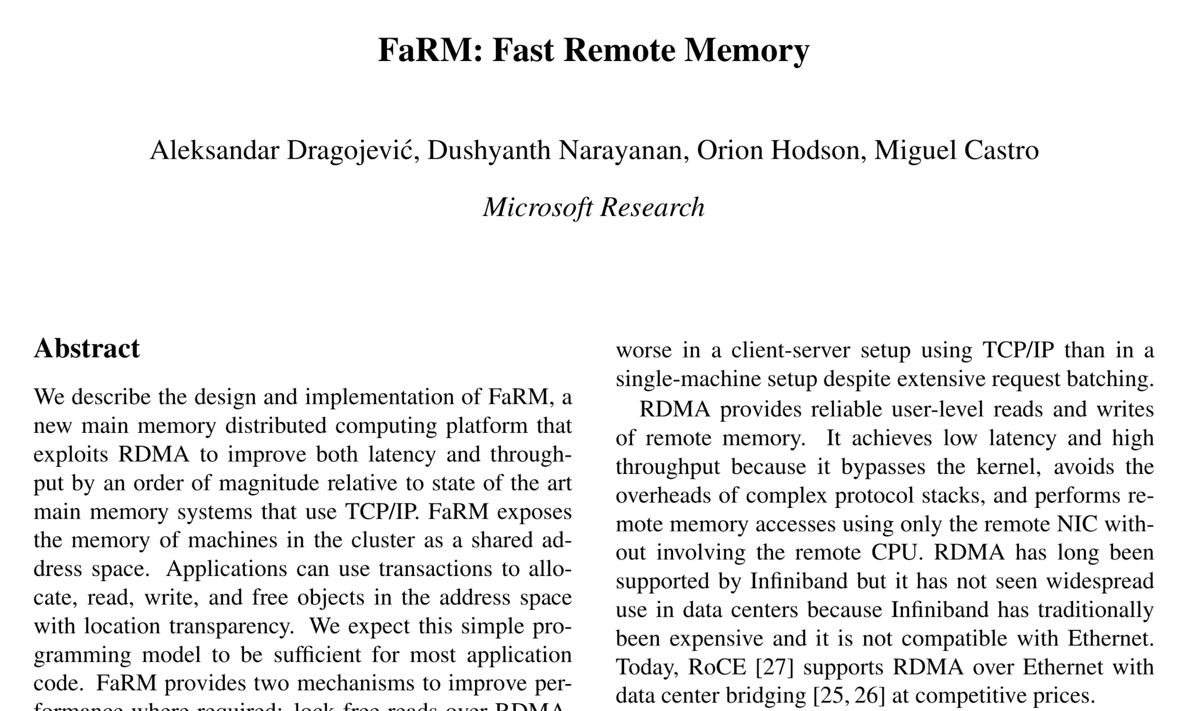
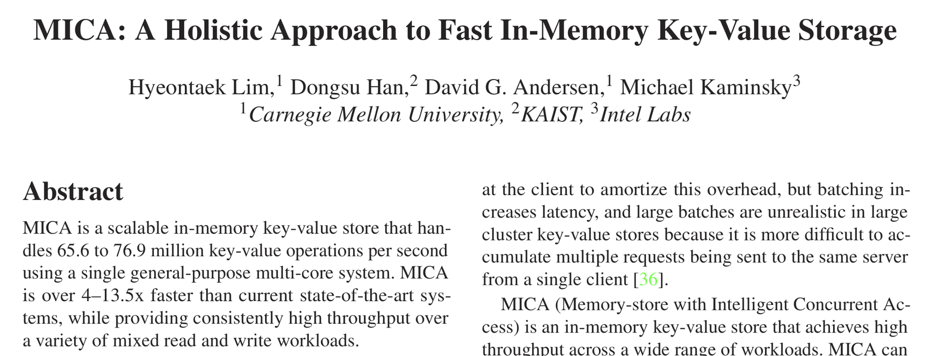
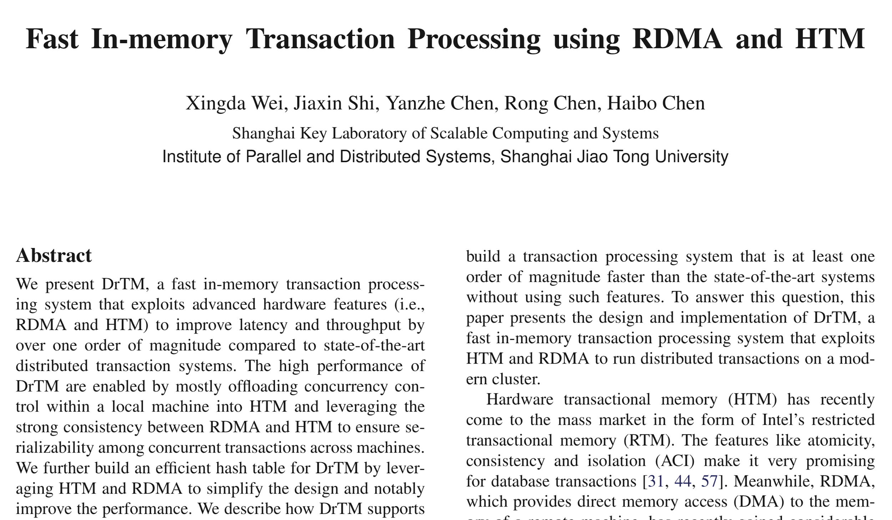
Key-Value Stores are Used Everywhere!
Notes:
Add more papers to the stack in another slide. People are still optimizing.

Slide 118
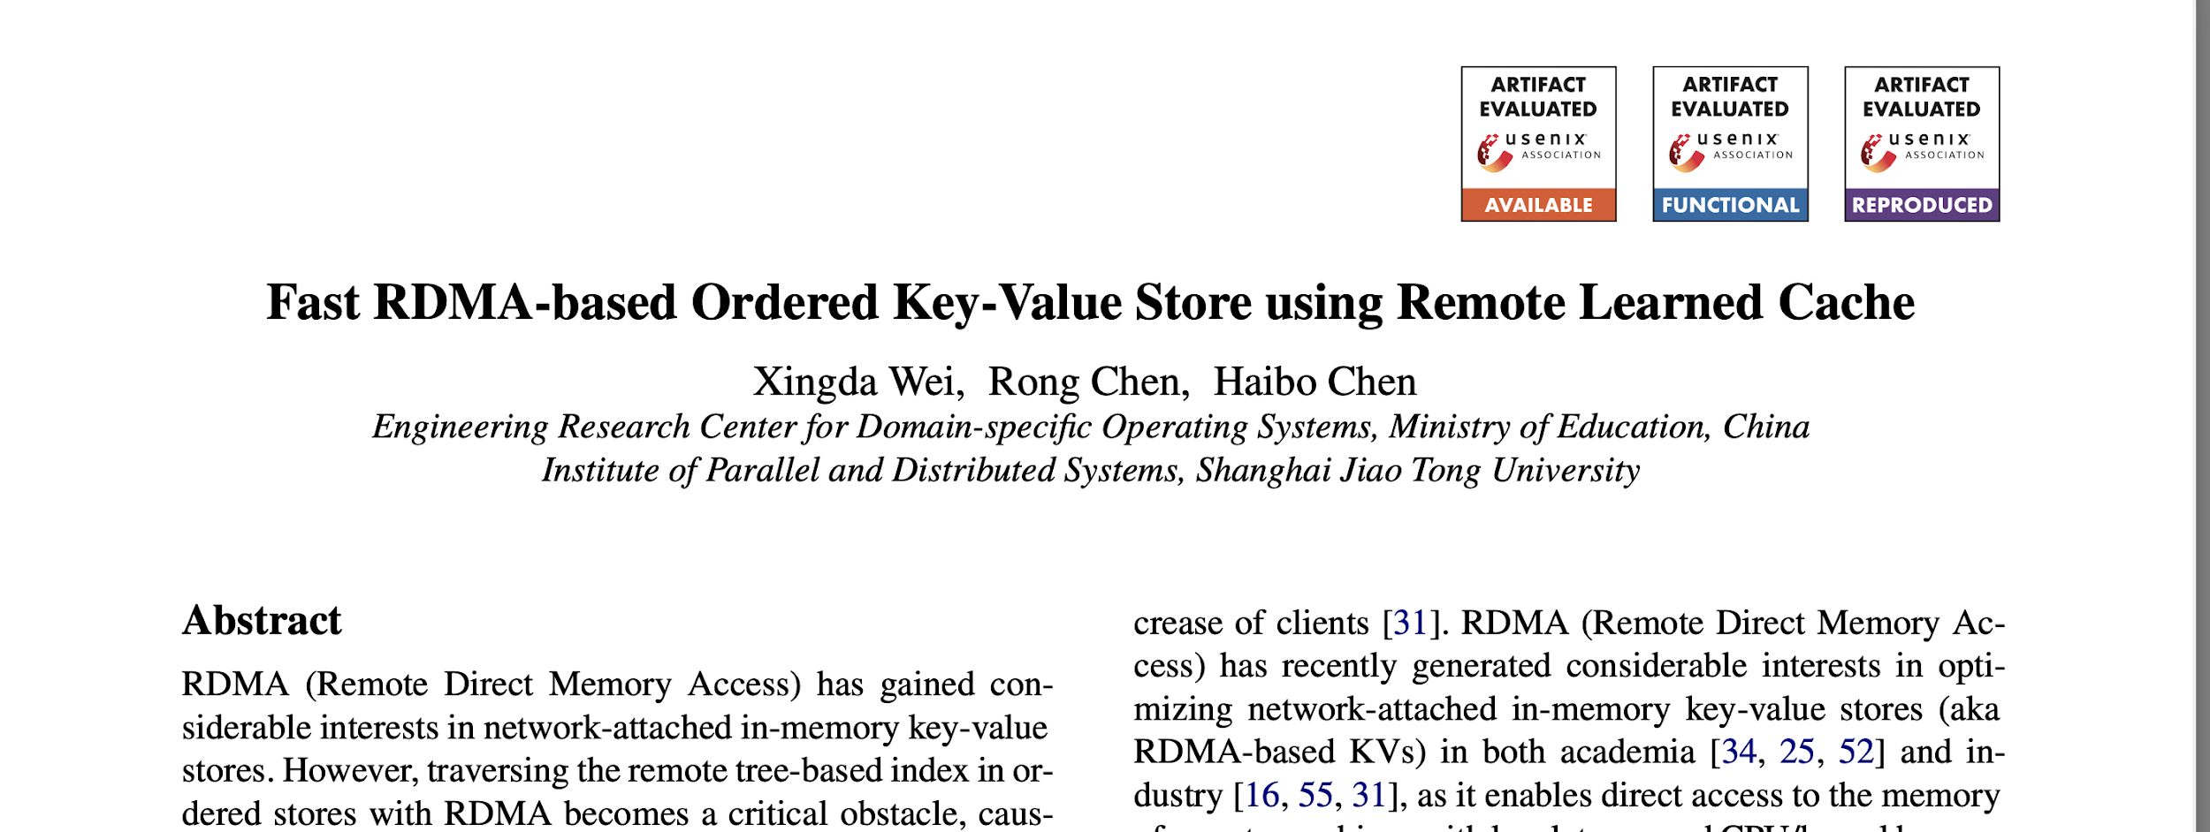
Key-Value Stores are Used Everywhere!
OSDI 2020
Notes:
Add more papers to the stack in another slide. People are still optimizing.

Slide 119
Shadowfax: TODO
Analyze larger-than-memory aspect of system
Throughput when data does not fit in main memory
What limits performance? What should change to improve performance?
Badrish: Cost benefit analysis with larger-than-memory

Slide 120
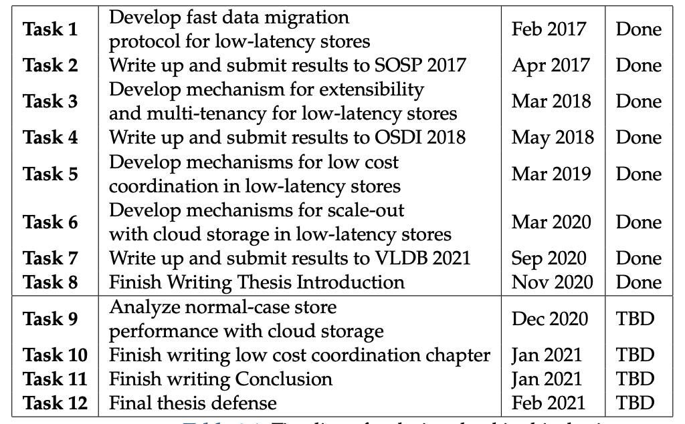
Thesis Timeline
Notes:
Add a TODO slide on Larger-than-memory eval

Slide 121
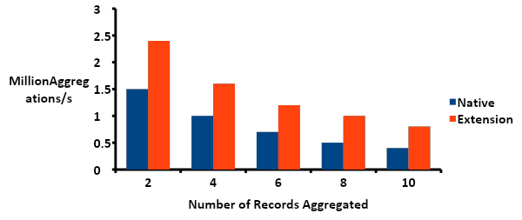
Simple Aggregation With Splinter
Extension Mode → Few RPCs, Less Data movement → Better Throughput
Notes:
Put TAO graph after this.
Talk about Ankit.

Slide 122
Key-Value Stores: Typical Deployment
Application
Client
Some systems support tables
64 bit hash space
per table
Put(key, value, table_id)
Get(key, table_id)
Server
Hash Table
Records
Notes:
Show hash table here.

Slide 123
Adaptive Placement for In-Memory Storage Functions
Ankit Bhardwaj (Labmate) has built on Splinter
For certain functions, client-side execution (gets & puts) is better
ASFP: Adaptive Storage Function Placement
Decouples function placement from execution
Dynamically models and decides where to execute functions
Published at ATC’20 (I am the second author)

